Slide 1
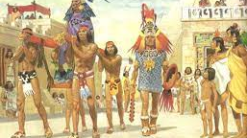
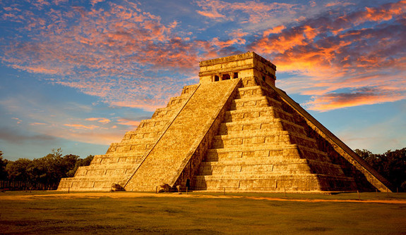
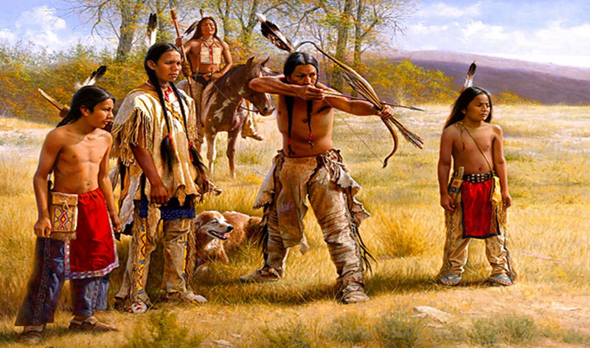
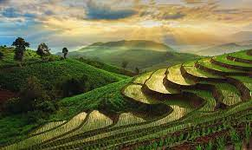
Chapter 6 review
American Natives

Slide 2
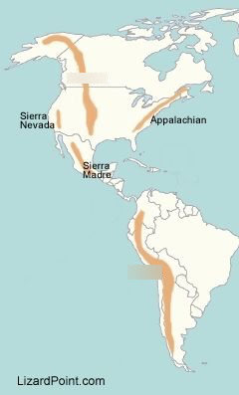
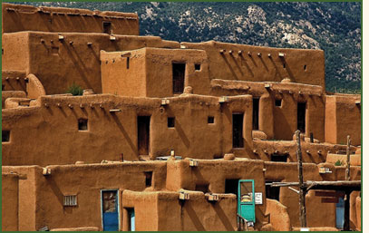
Identify the mountains.
A Rockies
B Andes
C Appalachian
A
C
Which region built these types of shelters?
Southwest North America
B

Slide 3
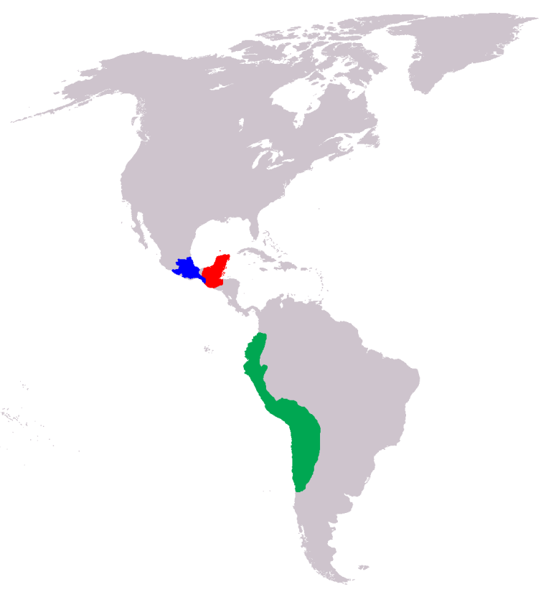
Identify the civilization by location
1
2
1 is Aztec
2 is Maya
3 is Inca
3

Slide 4
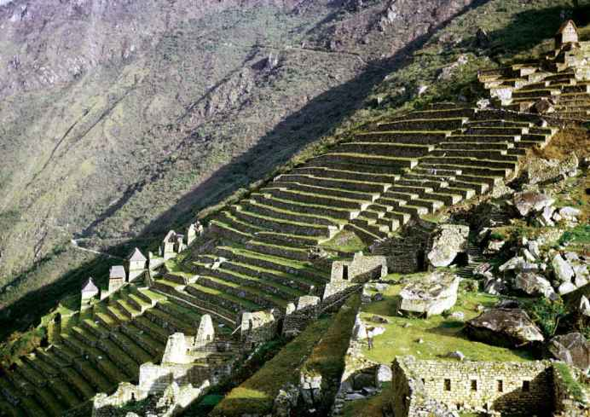
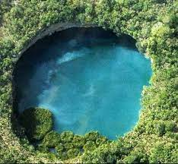
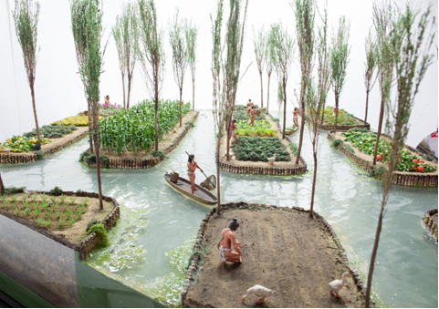
Mayan sinkhole
Identify the picture and who used it to overcome their environmental challenges?
Incan terrace farming
Aztec floating gardens

Slide 5
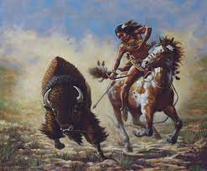
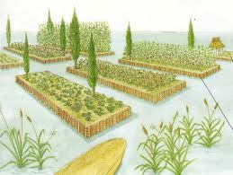
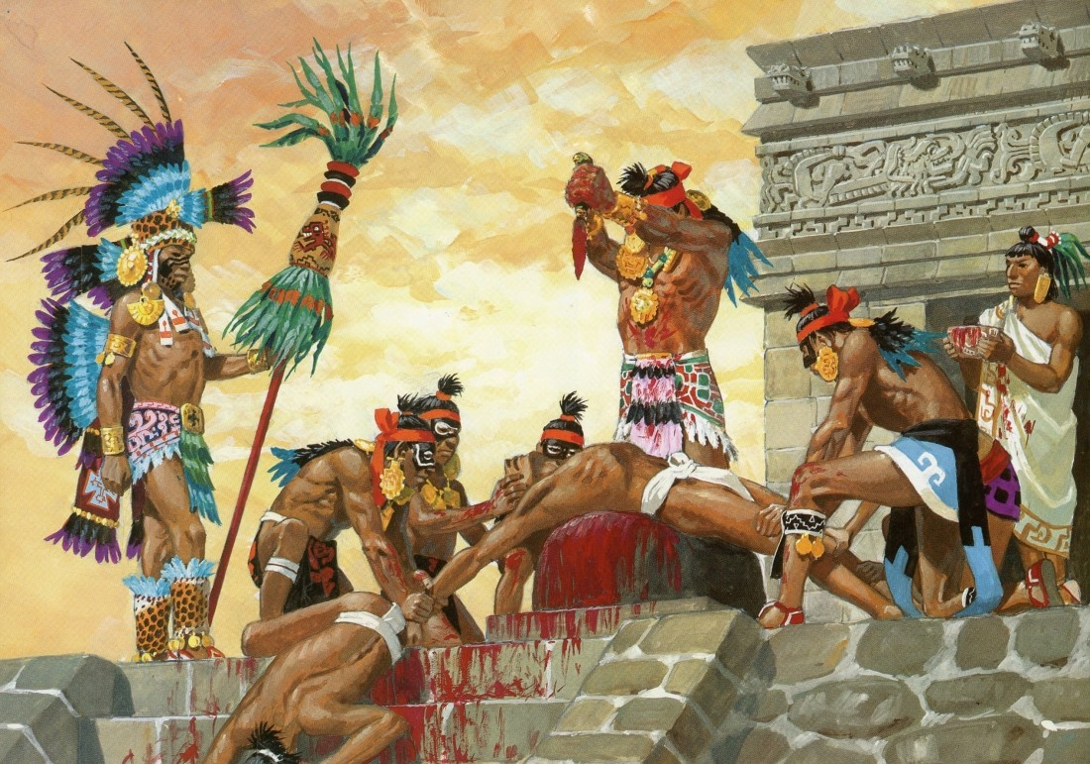
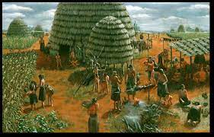
What two words best associate with Native American religions?
What made Maya number system unique in America?
Included a symbol for “0”
Polytheism and animism
What was the main animal the Great Plains natives relied on for survival?
Buffalo
Which civilization used chinampas to increase agriculture?
Aztecs
Why did Eastern woodland natives begin to farm?
What religious practice did both the Maya and Aztec take part in?
Human sacrifice
They lived in an area that had fertile soil

Slide 6
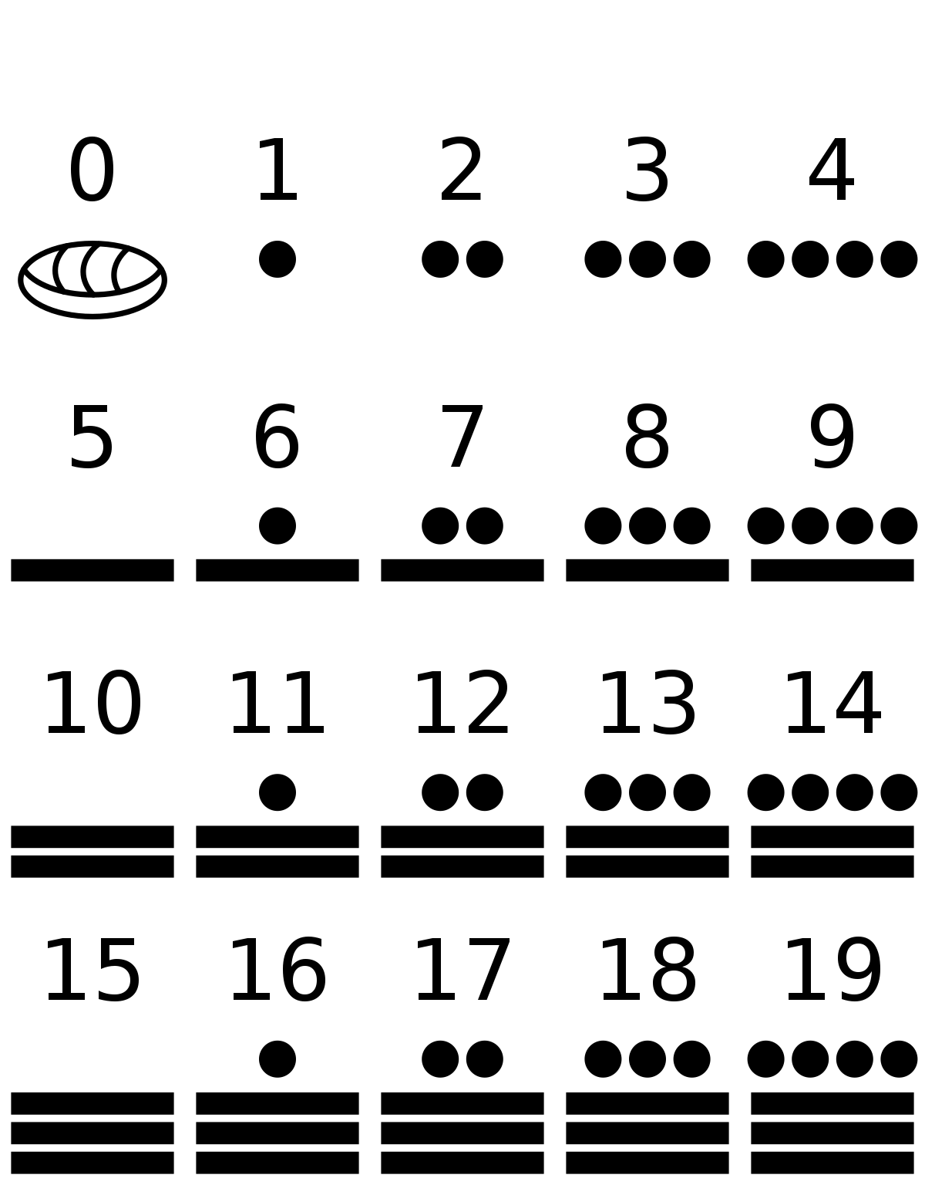
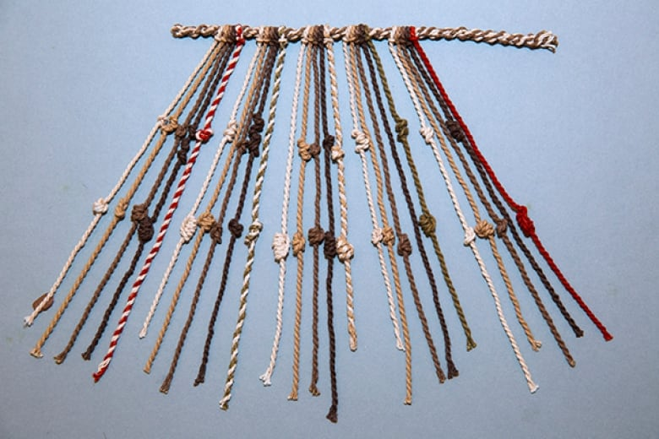
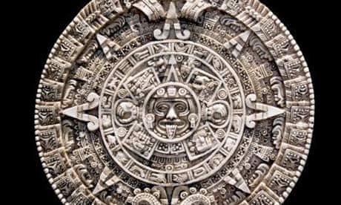
Inca –quipu knots math
Maya math
Identify the civilization and achievement
Maya and Aztec calendar

Slide 7
Maya
Who am I?
Lived in Yucatan peninsula
Used sink hole
Ruler descended from the sun god
Aztec
Who am I?
Lived in Mexico
Used floating gardens
Human sacrifice
Inca
Who am I?
Lived in Andes mts
Terraced farming
Very strong central government

Slide 8
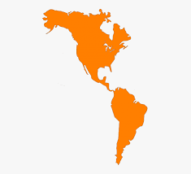
Identify the regions
1 North America
2 South America
3 Pacific Ocean
4 Atlantic Ocean
5 Gulf of Mexico
1
5
4
3
2

Slide 9
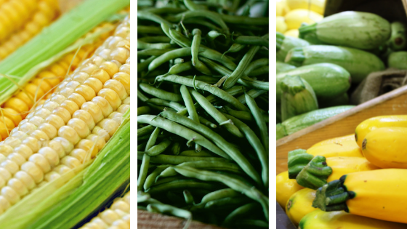
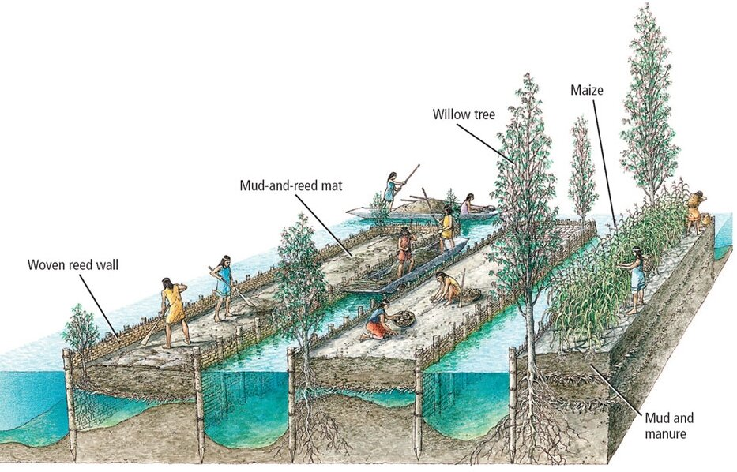
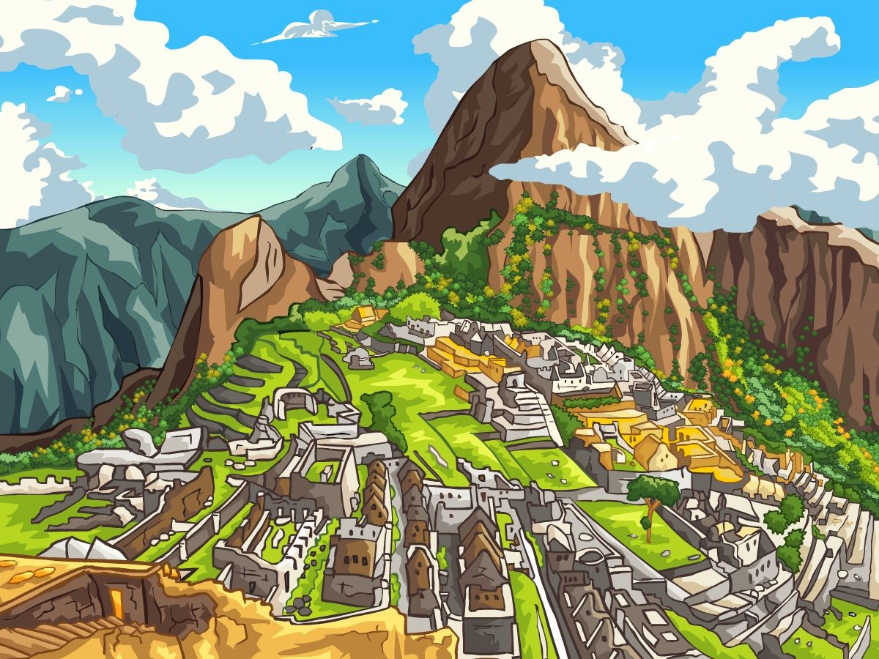
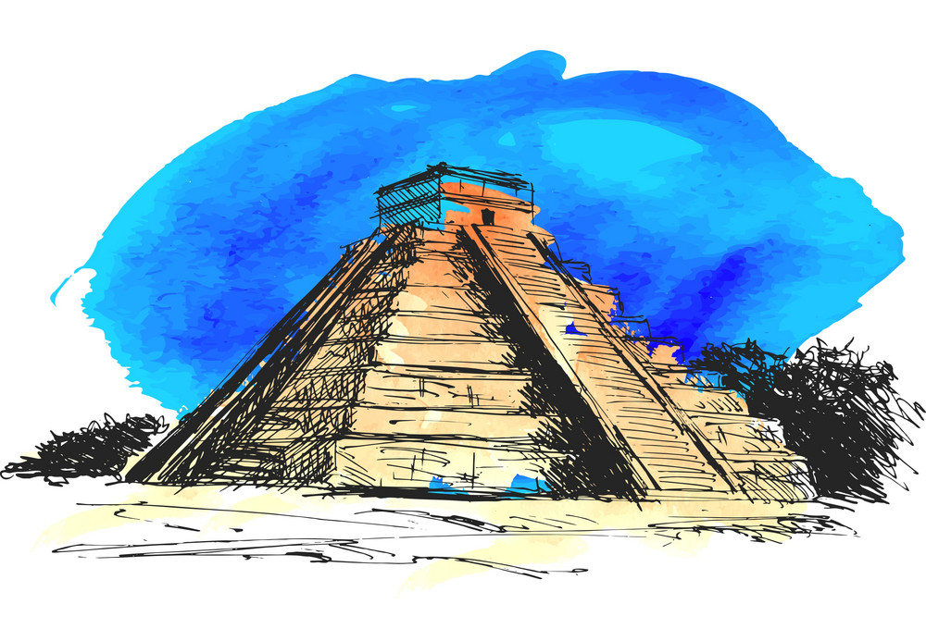
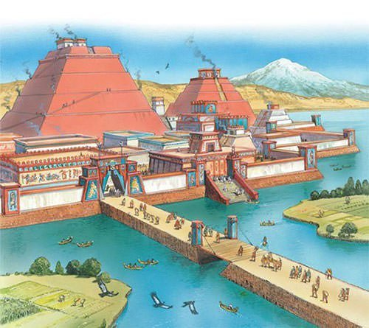
What are the “three sisters”?
What is essential for human survival?
The ability to adapt to your environment
Corn, Squash, and Beans
How were the Aztec, Maya, and Inca able to build such amazing structures without advanced technology?
They developed advanced mathematics and engineering techniques

